Slide 1
Growth Rate Comparison Using Graphs
Name: Udhayakumar U
Register Number:192424332
Department:AI & DS
Subject: Design And Analysis Algorithms
TECHNICAL PRESENTATION

Slide 2
Problem Statement
Compare the growth rates of O(n), O(n log n), and O(n²) using graphical representation.
The presentation should:
Define input range
State assumptions
Compare using graph and table
Explain which grows faster
Justify the conclusion
Provide insights for selecting algorithms

Slide 3
Introduction to Time Complexity
Time complexity measures how the execution time of an algorithm increases as the input size (n) grows.
Examples
O(n)
Linear Search
Finding Maximum Element
O(n log n)
Merge Sort
Heap Sort
Quick Sort (Average)
Complexity | Growth
O(n) | Linear
O(n log n) | Linearithmic
O(n²) | Quadratic
O(n²)
Bubble Sort
Selection Sort
Insertion Sort (Worst Case)

Slide 4
Assumptions and Input Range
Assumptions
Input size represented by n
All algorithms execute on the same computer
Constant hardware performance
Ignore compiler optimizations
Only asymptotic growth is considered
Input Range
N = 10,20,40,80,160,320

Slide 5
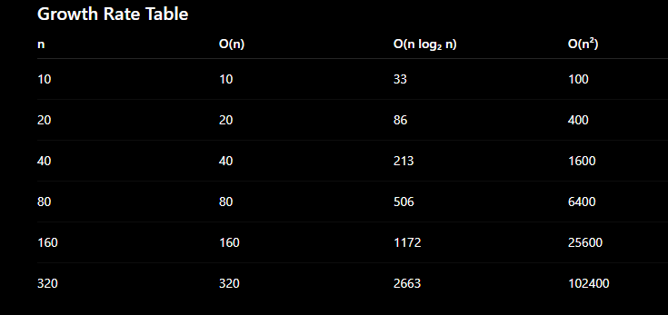
Numerical Comparison Table
Observation
Linear increases slowly.
O(n log n) grows moderately.
O(n²) increases very rapidly.

Slide 6
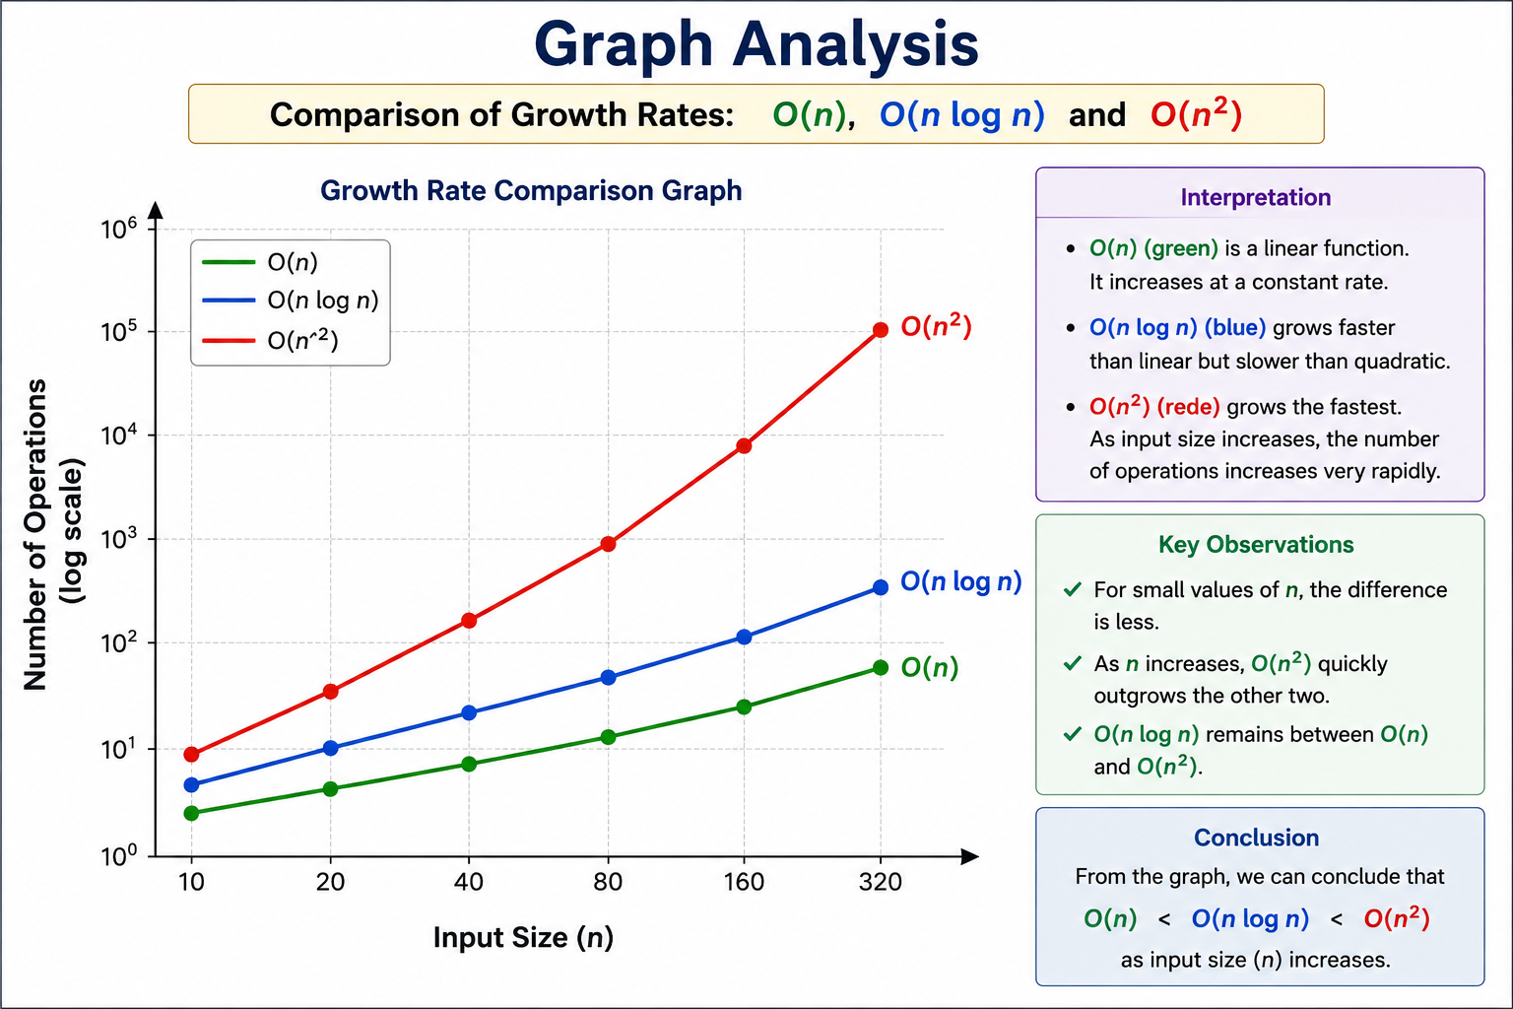
Graph Analysis
Graph Interpretation
X-axis
Input Size (n)
Y-axis
Number of Operations
Expected Curves
Analysis
O(n) is almost a straight line.
O(n log n) grows faster than linear.
O(n²) becomes extremely steep.

Slide 7
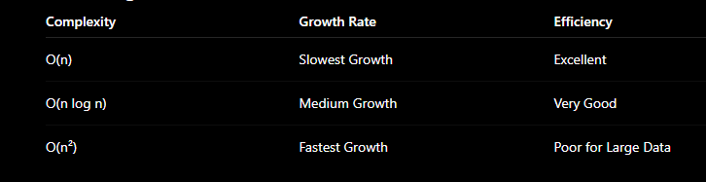
Comparative Analysis
Explanation
For small inputs:
n = 10
O(n)=10
O(n log n)=33
O(n²)=100
Which Algorithm Grows Faster?
For large inputs:
n = 320
O(n)=320
O(n log n)=2663
O(n²)=102400
Notice that O(n²) grows exponentially faster than the other two.

Slide 8
Conclusion
Key Findings
O(n) is the most efficient among the three.
O(n log n) provides an excellent balance between speed and functionality.
O(n²) becomes inefficient as the input size increases.
Best Performance
O(n)
↓
O(n log n)
↓
O(n²)
Worst Performance
As the input size increases, O(n) remains the most scalable, O(n log n) is efficient for sorting and divide-and-conquer algorithms, while O(n²) should generally be avoided for large datasets due to its rapid growth in execution time.

Slide 9


